Slide 1
INDUSTRIAL
ROBOT ARM
Edris Group : Ibrahem saber , Ahmed sami And Edris Yahya
Project Plan Smart Methods

Slide 2
Electronics and electrical power
Electronics and electrical power
Electronics and electrical power
Our Team
Ibrahem saber
Robot and artificial intelligence
Ahmed sami
Robot and artificial intelligence
Edris Yahya
Industrial
Abdulrahman
Electronics and electrical power

Slide 3


Project Plan
Teamwork
The way we work will be collective , The team will work together in all tasks and in parallel to conserve time, exchange experiences and skills, and preserve time
Our industrial robot arm is to help laboratories, and factories to increase production by carrying materials and small products.

Slide 4
Project Plan
Task Distribution
Industrial
allocate the tasks and responsibilities for the team members, determine the amount of time required, testing and reviewing the work.
Mechanics Responsible for the production line, taking measurements and designing the arm .
Electrics
Figuring out the needed electronic devices and how to program them and compute the degree of efficiency.
AI
Apply the sensors in the arm so it recognizes its surroundings and doesn’t hurt anyone.
IOT
supervise the development of the devices or sensors themselves, programming the software that allows us to control the arm.

Slide 5
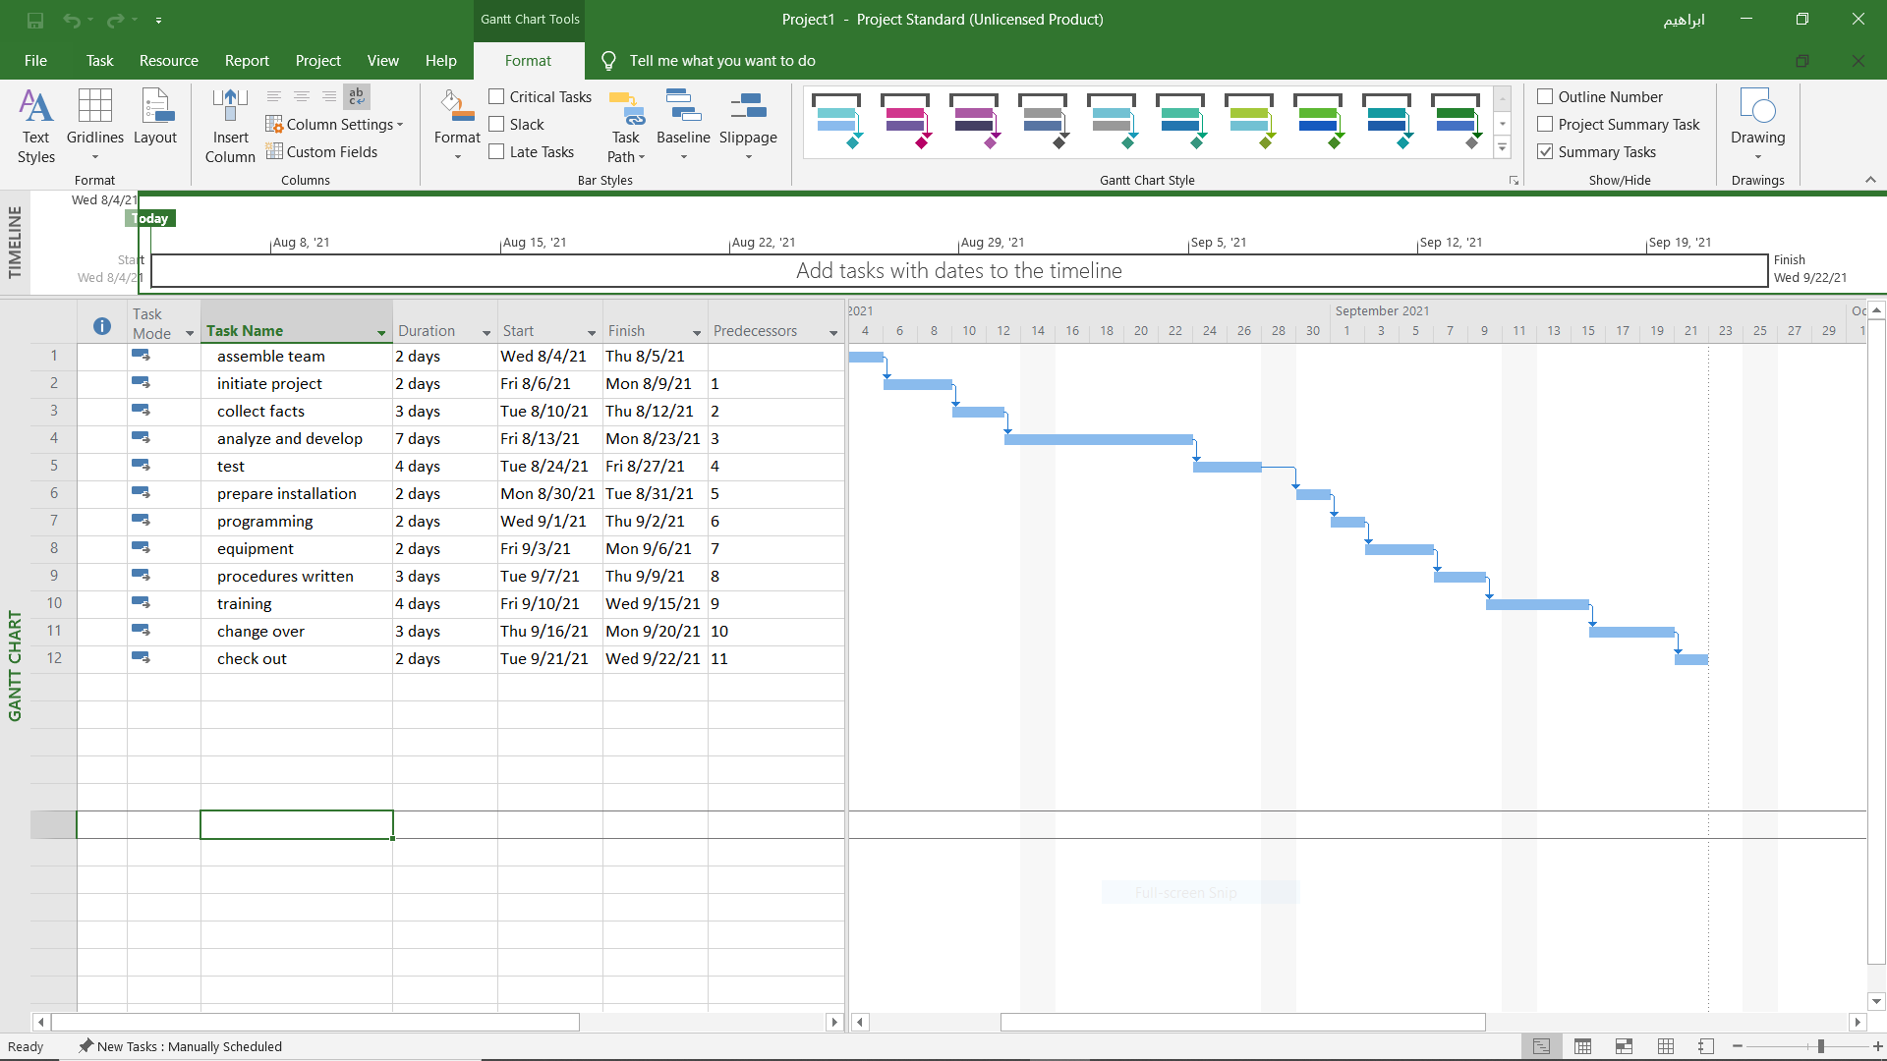
Timeline

Slide 6
Introduction
Robotic arms are generally made to simulate a human arm. This is achieved by giving it 7 various segments each part giving it a larger degree of motion.
Robot arms will often have: The above stated 7 various segments bound together with 6 joints
Programmable which gives the user a choice to rotate each motor at various times
Have multiple attachments, meaning a robot can have claw, drill, welder, spray gun etc.
• Various sensors to perform specific tasks.

Slide 7
Poduction Line
MODELLING
1. Cutting tool ,3D print and CNC
PACKEGS Box
ASSEMBLY Mechanical
PROGRAM App and Web

Slide 8
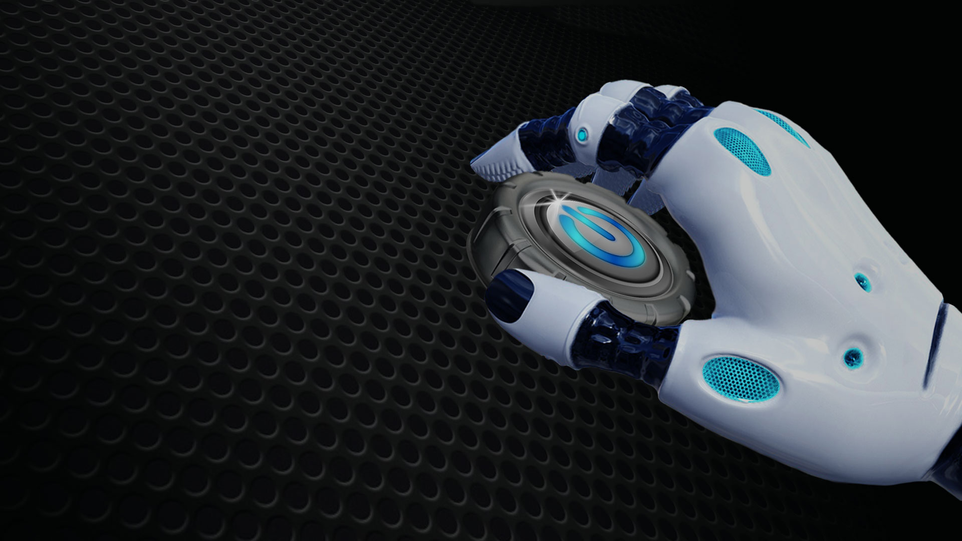
THANK YOU

